Slide 1
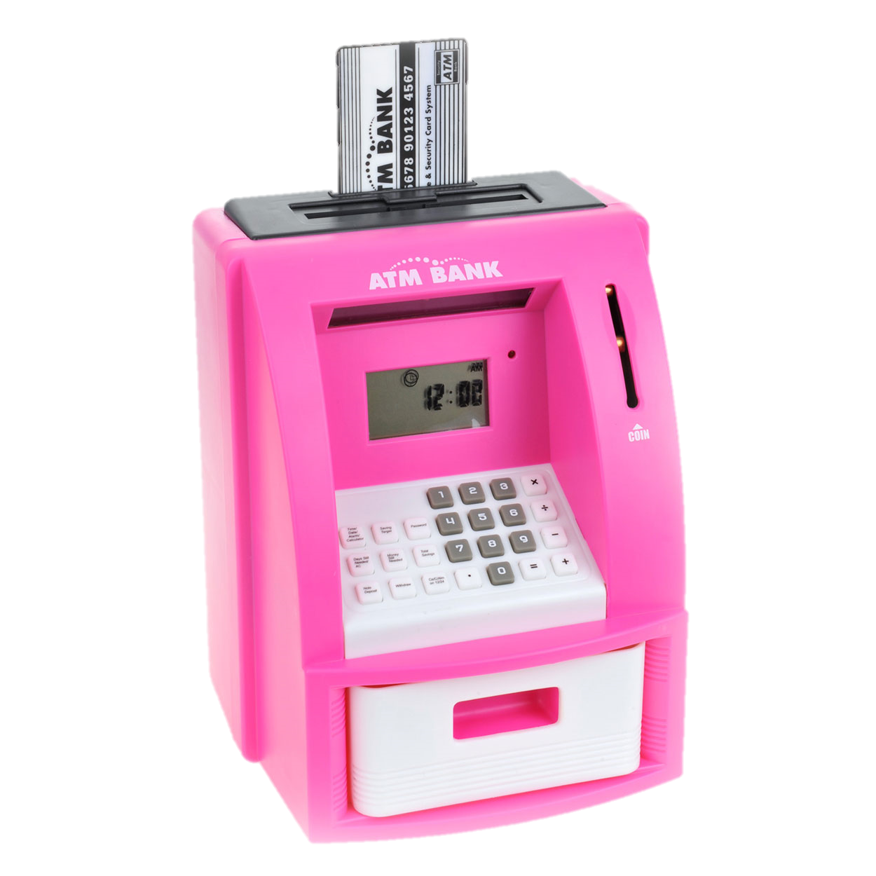
Project 3
Andre van der Wacht
Groep 4

Slide 2
Inleiding

Slide 3
Inhoud
Database
Hardware
Code
GUI
Demo
Must-, could- and should haves

Slide 4
Database

Slide 5
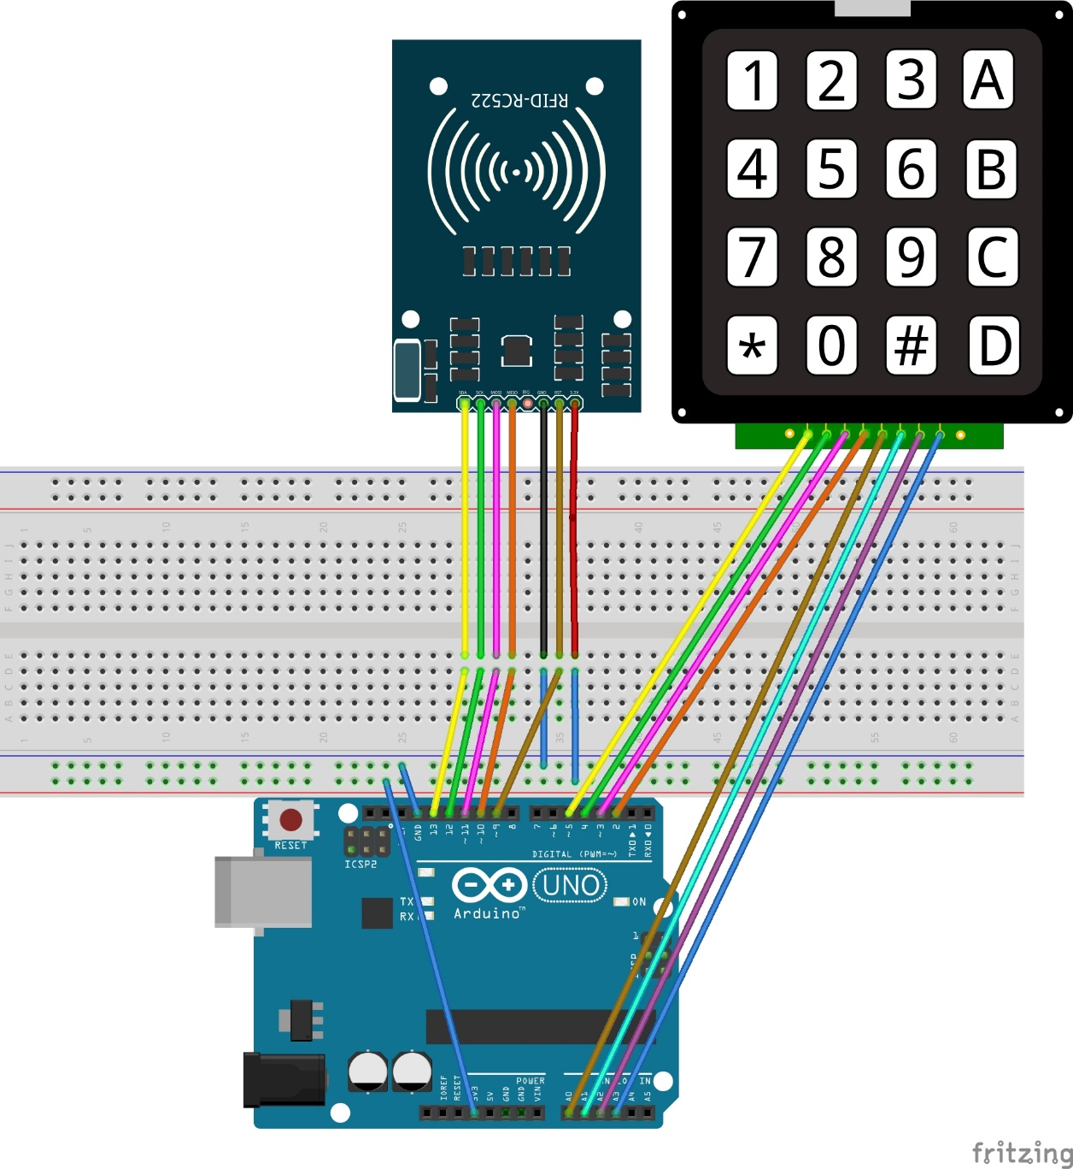
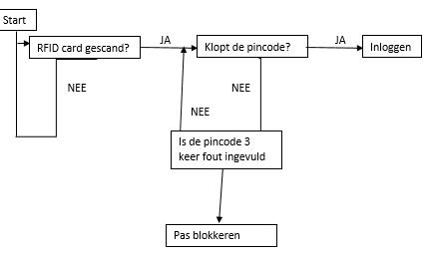
Hardware

Slide 6
Code

Slide 7
Code

Slide 8
GUI

Slide 9
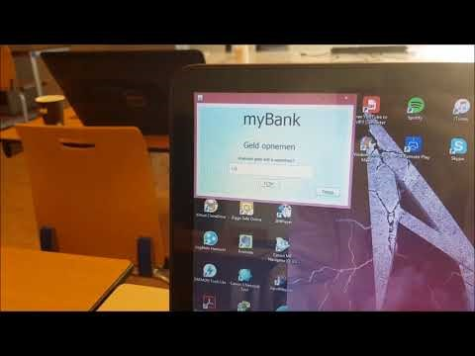
Demo

Slide 10
Product Backlogs

Slide 11
Product Backlogs

